Slide 1
Modern Methods in Data Analysis Lecture 2, 2020 Feature scales, K-means, and interpretation
Boris Mirkin
Professor, Data Analysis and AI, NRU HSE, Moscow, bmirkin@hse.ru, 8(963)-7234021
Professor Emeritus, Computer Science, Birkbeck UL, London UK, mirkin@dcs.bbk.ac.uk

Slide 2
A bit of administration:

Slide 3
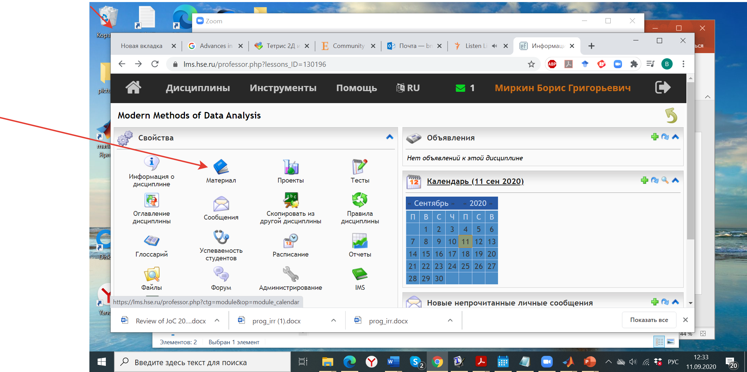
In LMS HSE: open the class page and go to Materials to find Lecture slides, Program, HW and Text

Slide 4
Modern Data Analysis Home Work 2020: Start and Deadline, 1
Goals:
Hands-on experience in data analysis methods learnt
Report writing experience
A report submitting team may consist of up to 4 persons: all are to receive the same mark.
To start, you should receive a confirmation from myself. To obtain that, you should submit to me a description of the dataset (what are the entities, the number of them, a list of features with explanation of their meaning, and a file with the dataset).

Slide 5
Modern Data Analysis Home Work 2020: Start and Deadline,2
A single file of your report of the homework must reach Instructor at bmirkin@hse.ru by the end of 6 December 2020 (till morning of 7 December).
Reports submitted after this deadline but before the end of 14 December will be penalized by 20% off the mark. Reports submitted later than 14 December will be penalized by 70%. No second submission is accepted after your submission has been acknowledged.

Slide 6
Lecture 2 Contents
Two formalizations of the concept of feature: vector (DA) and random variable (Classical Statistics/ML)
Quantitative and categorical features
Data standardization
How to categorize a quantitative feature.
Partition and its distribution.
K-means clustering and its issues.
K-means criterion.
Interpretation of clusters
The average and its properties
Data analysis: Vector view
Classical statistics: Density function view

Slide 7
Lecture 2 Contents
Two formalizations of the concept of feature: vector and random variable
Quantitative and categorical features
How to categorize a quantitative feature. Partition and its distribution.
K-means clustering.
Interpretation of clusters
The average and its properties
K-means criterion.

Slide 8
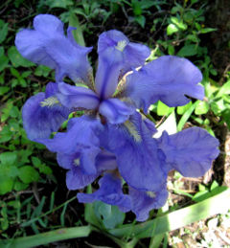
The most popular data tble: 150x4 Anderson–Fisher Iris Dataset
Iris flower
Sepal / Чашелистик
Petal / Лепесток
150×4 data of three taxa:
Taxon
#1-50 Iris setosa (diploid)
#51-100 Iris versicolor (tetraploid)
#101-150 Iris virginica (hexaploid)
Features
W1 Sepal length
W2 Sepal width
W3 Petal length
W4 Petal width
Taxa
Metadata

Slide 9
Iris, features w1, w2, w3, w4
# | Iris
 | w1 w2 w3 w4
1 2 3 4 5 6 7 8 9 … 150 | 5.1 3.5 1.4 0.3 4.4 3.2 1.3 0.2 4.4 3.0 1.3 0.2 5.0 3.5 1.6 0.6 5.1 3.8 1.6 0.2 4.9 3.1 1.5 0.2 5.0 3.2 1.2 0.2 4.6 3.2 1.4 0.2 5.0 3.3 1.4 0.2 ….. 5.1 3.5 1.4 0.2
Consider feature w1. How to model it? Data Science: entries in w1 matter only!!!

Slide 10
What is feature w1? According to Data Science view, just the column w1’s contents:
Index 1 through 9
5.1 4.4 4.4 5.0 5.1 4.9 5.0 4.6 5.0
. . . . . . . . . . . . . . . . . . . . . . . . .
Index 142 through 150
6.7 6.3 6.5 6.5 7.3 6.7 5.6 6.4 6.5
What is this
as a mathematical object?

Slide 11
What is the column w1’s contents as a mathematical object? :
Index 1 through 9
5.1 4.4 4.4 5.0 5.1 4.9 5.0 4.6 5.0
. . . . . . . . . . . . . . . . . . . . . . . . .
Index 142 through 150
6.7 6.3 6.5 6.5 7.3 6.7 5.6 6.4 6.5
Two different views co-exist in Data Science (like the photon, unit of light, in Quantum Physics: both a particle and a wave)

Slide 12
Two different views, A) and B), at the w1 feature as a mathematical object: :
Index 1 through 9
5.1 4.4 4.4 5.0 5.1 4.9 5.0 4.6 5.0
. . . . . . . . . . . . . . . . . . . . . . . . .
Index 142 through 150
6.7 6.3 6.5 6.5 7.3 6.7 5.6 6.4 6.5
Data Analysis: Vector of 150x1 dimension
Classical Statistics: 150-strong sample from a random variable

Slide 13
A) Feature as vector, 1:
Index 1 through 9
5.1 4.4 4.4 5.0 5.1 4.9 5.0 4.6 5.0
. . . . . . . . . . . . . . . . . . . . . . . . .
Index 142 through 150
6.7 6.3 6.5 6.5 7.3 6.7 5.6 6.4 6.5
Math: Given a set I of object indices or names, feature is a mapping f: I→R where R is the set of all reals, that is,
f=(f_{i}), i∈I, an |I|-dimensional vector

Slide 14
A) Feature as vector, 2:
Index 1 through 9
5.1 4.4 4.4 5.0 5.1 4.9 5.0 4.6 5.0
. . . . . . . . . . . . . . . . . . . . . . . . .
Index 142 through 150
6.7 6.3 6.5 6.5 7.3 6.7 5.6 6.4 6.5
Pro: a) Intuitive;
b) Objects are explicit (rows)
c) Linear algebra applies
Con: d) Empirical (depends on I, cannot be extended to the universe)

Slide 15
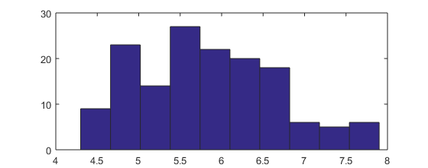
B) Feature as random variable, 1:
Index 1 through 9
5.1 4.4 4.4 5.0 5.1 4.9 5.0 4.6 5.0
. . . . . . . . . . . . . . . . . . . . . . . . .
Index 142 through 150
6.7 6.3 6.5 6.5 7.3 6.7 5.6 6.4 6.5
Histogram: range is divided in n(=10) bins; numbers of objects falling in bins are presented by bars.

Slide 16
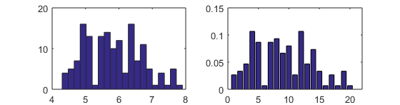
B) Feature as random variable, 2: :
(a) (b)
Histogram: (a) range is divided in n(=20) bins; numbers of objects falling in bins, frequencies, are presented by bars.
Relative histogram: (b) bars express proportions of objects in the bins (relative freq., sum to 1).

Slide 17
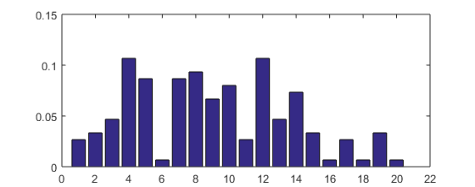

B) Feature as random variable, 3: :
Relative histogram: bars express proportions of objects in the n bins.
Density function, an abstraction of histogram at N and n tending to infinity: “measurable” nonnegative function (curve) f(x) such that $\int_{−∞}^{+∞}{f\left(x\right)dx=1}.$

Slide 18
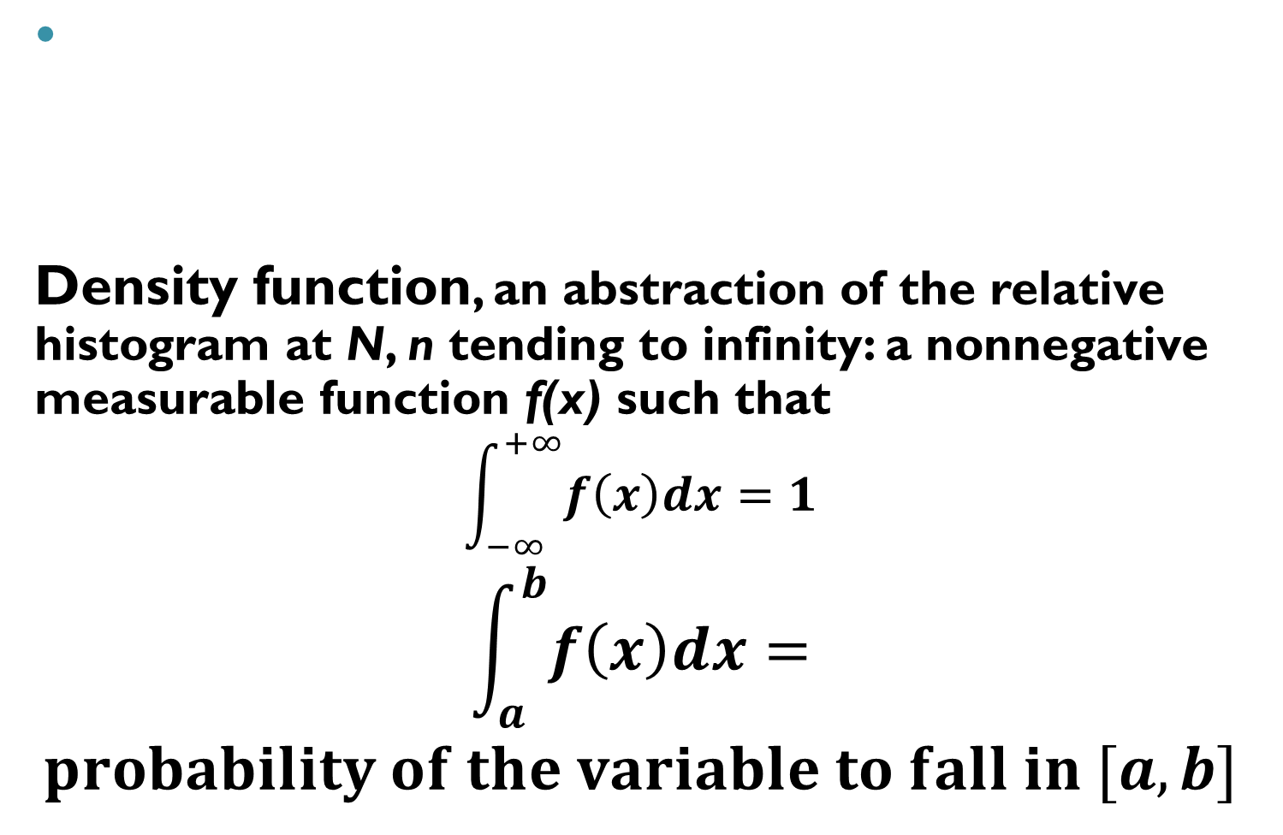
B) Feature as random variable, 4: :
Density function, an abstraction of the relative histogram at N, n tending to infinity: a nonnegative measurable function f(x) such that
$$\int_{−∞}^{+∞}{f\left(x\right)dx=1}$$
$$\int_{a}^{b}{f\left(x\right)dx=}$$
$$probability of the variable to fall in [a,b]$$
f(x)
0 a b x

Slide 19
B) Feature as random variable, 5: :
Math:
Feature = Random variable = Density function
Pro: (a) Universal, does not depend on set I
(b) Probability theory can be used
Con: (c) Objects are implicit
f(x)
0 a b x

Slide 20
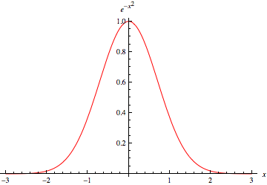
B) Popular density functions: Gaussian N(0,1) f(x) = Cexp{-x²}

Slide 21
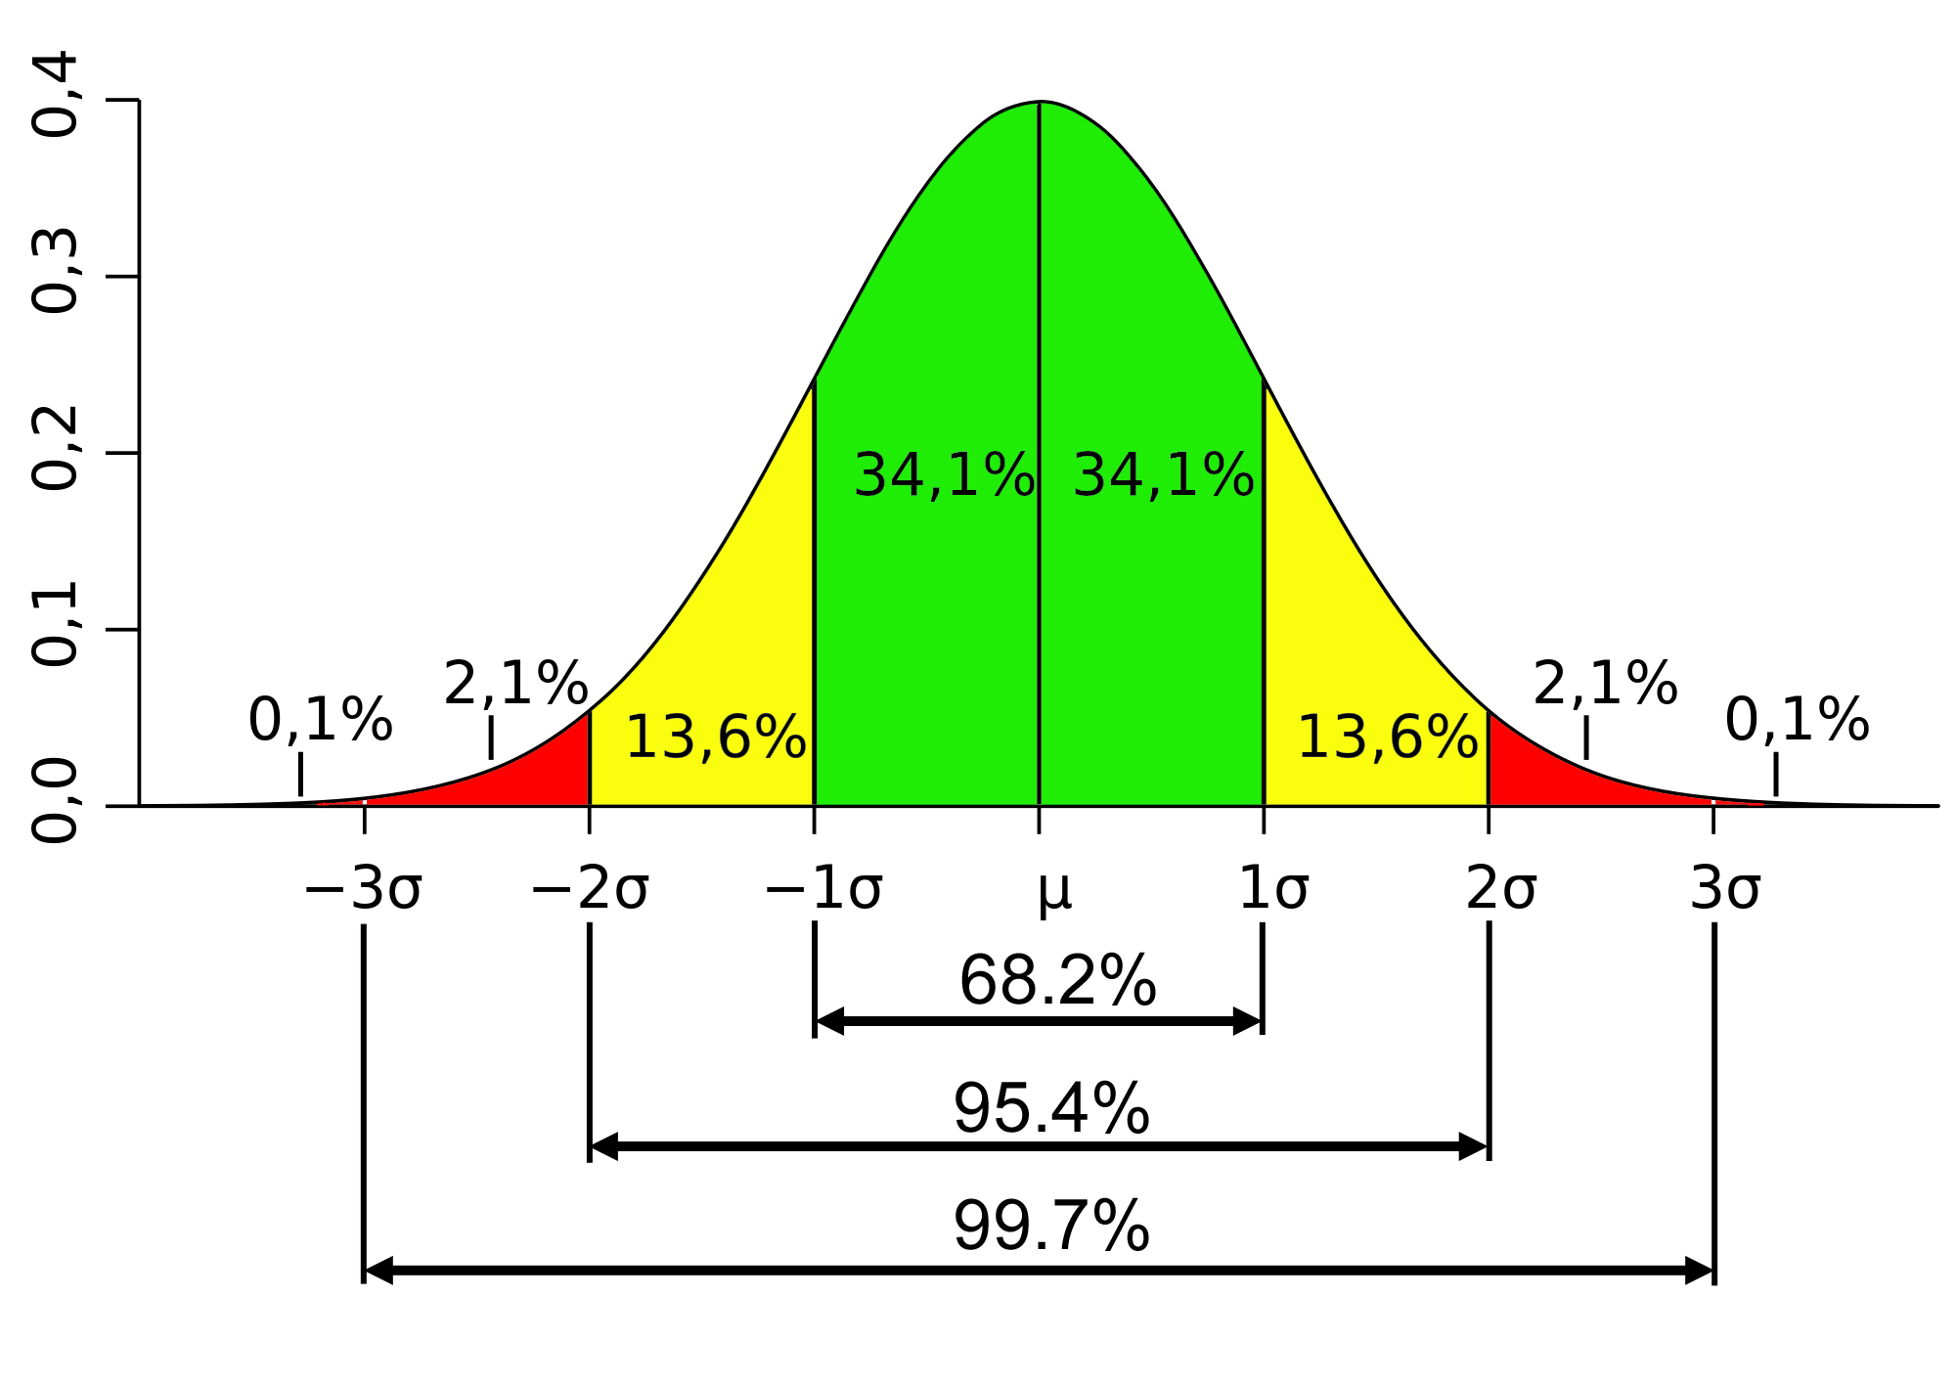

B) Popular density functions: general Gaussian N(μ,σ)
f(x)=exp($\frac{−{(x−\text{μ})}^{2}}{2σ^{2}})/\sqrt{2πσ^{2}}$
μ is mean
$σ^{2}$ is variance; $σ,$ the std

Slide 22
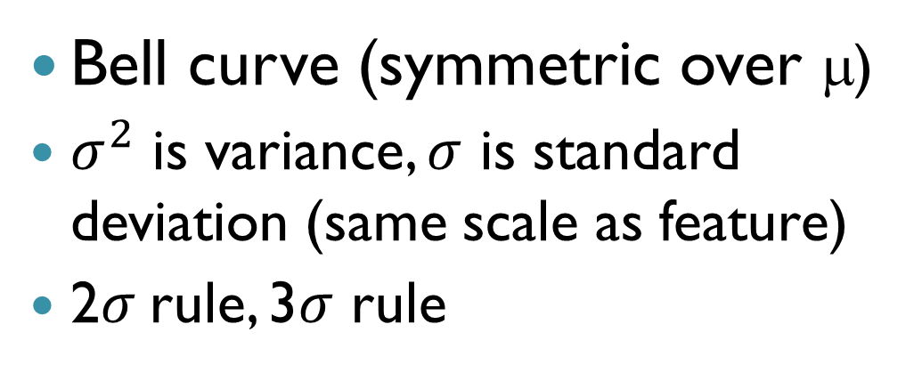
B) General Gaussian N(μ,σ)
Bell curve (symmetric over μ)
$σ^{2}$ is variance, $σ$ is standard deviation (same scale as feature)
2$σ$rule, 3$σ$ rule

Slide 23
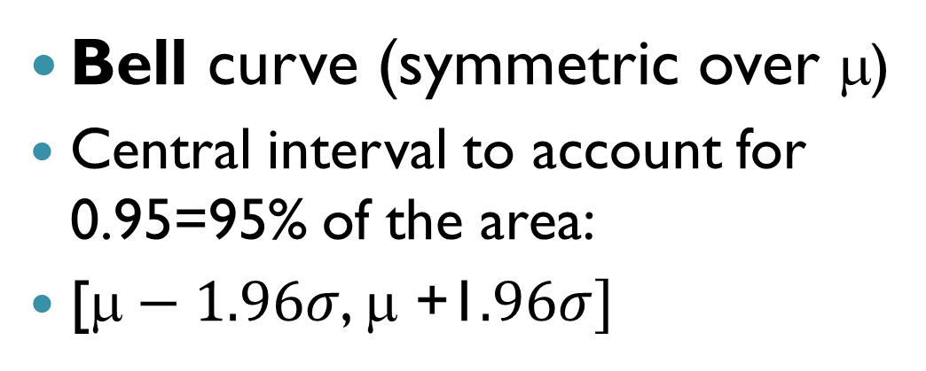
B) General Gaussian N(μ,σ)
Bell curve (symmetric over μ)
Central interval to account for 0.95=95% of the area:
[$\text{}−1.96σ$, μ +1$.96σ]$

Slide 24
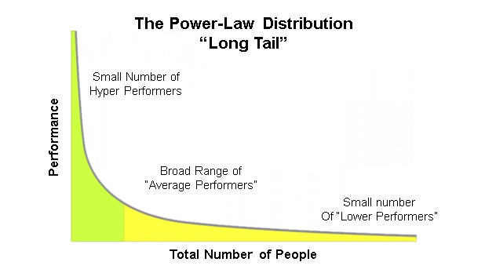
B) Popular density functions: Power law
f(x)=cx^{−α}
α the steepness
Scale-free (why? Can you tell?)
No mean
Matthew effect (see next slide)
ABC Classification
Huge number of
“Low performers”

Slide 25
B) Power law: Matthew effect
“For unto every one that hath shall be given, and he shall have abundance: but from him that hath not shall be taken even that which he hath.” Matthew Gospel 25:29
Examples:
Wealth
Quotations
Web site popularity
Huge number of “Low performers”

Slide 26
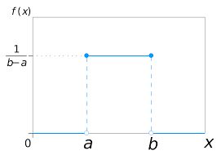
B) Popular density functions: uniform distribution over [a, b] interval
Why is
that?

Slide 27
Lecture 2 Contents
Two formalizations of the concept of feature: vector and random variable
Quantitative and categorical features
Data standardization
How to categorize a quantitative feature.
Partition and its distribution.
K-means clustering.
Interpretation of clusters
The average and its properties
K-means criterion.

Slide 28
Mixed feature scales: Another illustrative Data table
Companies characterized by mixed scale features; first three companies making product A, next three making product B, and the last two product C.
Company name | Income, $mln | MShare,% | NSup | AA | Sector
Aversiona Antyops Astonite | 19.0 29.4 23.9 | 43.7 36.0 38.0 | 2 3 3 | No No No | Utility Utility Manufacture
Bayermart Breaktops Bumchista | 18.4 25.7 12.1 | 27.9 22.3 16.9 | 2 3 2 | Yes Yes Yes | Utility Manufacture Manufacture
Civiok Cyberdam | 23.9 27.2 | 30.2 58.0 | 4 5 | Yes Yes | Retail Retail

Slide 29
Company Dataset scales,1
Metadata: Object names, Features and Domain knowledge
1) Income, $ Mln;
2) MShare - Market share , per cent;
3) NSup - Number of principal suppliers;
4) AA: Affirmative Action - Yes or No;
5) Sector - (a) Retail, (b) Utility, and (c) Manufacture.
Feature: Maps entities to feature values
Quantitative scale: Arithmetic mean makes sense Examples: 1) Income, 2) MShare, 3) Nsup
Binary scale: 1/0 coding makes it quantitative (mean=proportion) Example: 4) AA, m=3/4

Slide 30
Company Dataset scales,2
Metadata: Object names, Features and Domain knowledge
1) Income, $ Mln;
2) MShare - Market share , per cent;
3) NSup - Number of principal suppliers;
4) AA (Affirmative Action) - Yes or No;
5) Sector - (a) Retail, (b) Utility, and (c) Manufacture.
Plus: The names – three products, A, B, and C
Feature: Maps entities to feature values
Nominal scale: categories are exclusive, no relations (corresponds to partition of the set of objects), Example: 5) Sector
Order scale: categories are exclusive, linearly ordered ((corresponds to ranking of the set of objects) Example: ?

Slide 31
Company dataset
Company name | Income, $mln | MShare,% | NSup | AA | Sector
Aversiona Antyops Astonite | 19.0 29.4 23.9 | 43.7 36.0 38.0 | 2 3 3 | No No No | Utility Utility Manufacture
Bayermart Breaktops Bumchista | 18.4 25.7 12.1 | 27.9 22.3 16.9 | 2 3 2 | Yes Yes Yes | Utility Manufacture Manufacture
Civiok Cyberdam | 23.9 27.2 | 30.2 58.0 | 4 5 | Yes Yes | Retail Retail
Data analysis issues:

Slide 32
Company dataset
Company name | Income, $mln | MShare,% | NSup | AA | Sector
Data analysis issues:
How to map companies to screen, to reflect similarity in distances between points? (Summarization)
Would clustering of companies reflect the product? What features would be involved? (Summarization)
Can rules be derived to predict the product for a company coming outside of the table? (Correlation)
Is there any relation between the structural features (NSup, AA, Sector) and market related features (Income, MShare)? (Correlation)

Slide 33
Lecture 2 Contents
Two formalizations of the concept of feature: vector and random variable
Quantitative and categorical features
Data preprocessing & standardization
How to categorize a quantitative feature.
Partition and its distribution.
K-means clustering.
Interpretation of clusters
The average and its properties
Vector view
Density function view
K-means criterion.

Slide 34
Company Dataset: Quantification
Case 1: Companies 4
Company name | Income, $mln | MShare,% | NSup | AA | Sector
Aversiona Antyops Astonite | 19.0 29.4 23.9 | 43.7 36.0 38.0 | 2 3 3 | No No No | Utility Utility Manufacture
Bayermart Breaktops Bumchista | 18.4 25.7 12.1 | 27.9 22.3 16.9 | 2 3 2 | Yes Yes Yes | Utility Manufacture Manufacture
Civiok Cyberdam | 23.9 27.2 | 30.2 58.0 | 4 5 | Yes Yes | Retail Retail
Quantitative coding: Each category is made into a 1/0 binary (dummy) feature “Does it hold? 1 if Yes, 0 if No.”
Entity | Income | MShar | NSup | AA? | Util? | Manu? | Retail?
1 2 3 | 19.0 29.4 23.9 | 43.7 36.0 38.0 | 2 3 3 | 0 0 0 | 1 1 0 | 0 0 1 | 0 0 0
4 5 6 | 18.4 25.7 12.1 | 27.9 22.3 16.9 | 2 3 2 | 1 1 1 | 1 0 0 | 0 1 1 | 0 0 0
7 8 | 23.9 27.2 | 30.2 58.0 | 4 5 | 1 1 | 0 0 | 0 0 | 1 1
Company data 8×5 converted into a quantitative format 8×7

Slide 35
Pre-processing: - quantification - filling in missings (not covered) - standardization
Standardization:
shift of the origin to a to compare data with a “norm”
rescaling by relating to b to make features comparable
Y_{iv} = (X_{iv} –a_{v})/b_{v}
X - original data
Y – standardized data
a_{v} – shift of the origin, typically, the average
b_{v} – rescaling factor, traditionally the standard deviation (from statistics perspective), but range may be better

Slide 36
Company Dataset: Standardization
Company data 8×5 converted to the quantitative format 8×7
# | Inco | MSch | NSup | EC | Util | Indu | Reta
1 2 3 | 19.0 29.4 23.9 | 43.7 36.0 38.0 | 2 3 3 | 0 0 0 | 1 1 0 | 0 0 1 | 0 0 0
4 5 6 | 18.4 25.7 12.1 | 27.9 22.3 16.9 | 2 3 2 | 1 1 1 | 1 0 0 | 0 1 1 | 0 0 0
7 8 | 23.9 27.2 | 30.2 58.0 | 4 5 | 1 1 | 0 0 | 0 0 | 1 1
Three standardizations:
(i), (ii), (iii) (see next)
Why are that many, and what is the need in data standardization?
Goal: to sharpen the data structure
# | Inco | MSch | NSup | AA | Util | Man | Reta
1 2 3 | 19.0 29.4 23.9 | 43.7 36.0 38.0 | 2 3 3 | 0 0 0 | 1 1 0 | 0 0 1 | 0 0 0
4 5 6 | 18.4 25.7 12.1 | 27.9 22.3 16.9 | 2 3 2 | 1 1 1 | 1 0 0 | 0 1 1 | 0 0 0
7 8 Mean | 23.9 27.2 22.45 | 30.2 58.0 34.12 | 4 5 3.00 | 1 1 .625 | 0 0 .375 | 0 0 .375 | 1 1 0.25
Data standardization goals in DA (unlike in ClSt):
Feature centering: to look at feature values against a “normal” backdrop
Feature normalization: to balance feature weights

Slide 37
Company Dataset: Standardization (i)
-3.45 9.58 -1 -0.62 0.62 -0.38 -0.25
6.95 1.88 0 -0.62 0.62 -0.38 -0.25
1.45 3.88 0 -0.62 -0.38 0.62 -0.25
-4.05 -6.22 -1 0.38 0.62 -0.38 -0.25
3.25 -11.82 0 0.38 -0.38 0.62 -0.25
-10.35 -17.22 -1 0.38 -0.38 0.62 -0.25
1.45 -3.92 1 0.38 -0.38 -0.38 0.75
4.75 23.88 2 0.38 -0.38 -0.38 0.75
Structure of data at standardization
(i): centering
Color/shape corresponds
to the product (A,B,C)
This structure has nothing to do with product

Slide 38
Company Dataset: Standardization (ii)
-0.20 0.23 -0.33 -0.62 0.62 -0.38 -0.25
0.40 0.05 0 -0.62 0.62 -0.38 -0.25
0.08 0.09 0 -0.62 -0.38 0.62 -0.25
-0.23 -0.15 -0.33 0.38 0.62 -0.38 -0.25
0.19 -0.29 0 0.38 -0.38 0.62 -0.25
-0.60 -0.42 -0.33 0.38 -0.38 0.62 -0.25
0.08 -0.10 0.33 0.38 -0.38 -0.38 0.75
0.27 0.58 0.67 0.38 -0.38 -0.38 0.75
Structure of data at standardization
(ii) centering and normalizing by range
Color/shape correspond to the product (A,B,C)
This structure somewhat corresponds to product

Slide 39
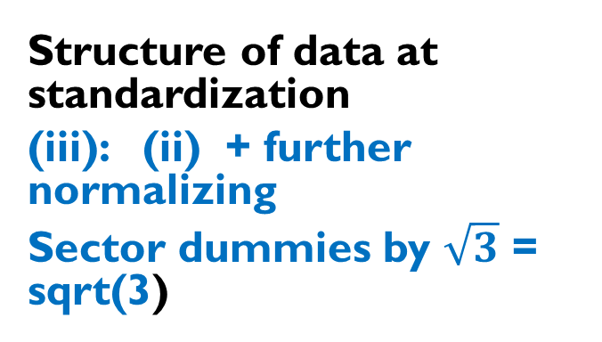
Company Dataset: Standardization (iii)
-0.20 0.23 -0.33 -0.62 0.36 -0.22 -0.14
0.40 0.05 0 -0.62 0.36 -0.22 -0.14
0.08 0.09 0 -0.62 -0.22 0.36 -0.14
-0.23 -0.15 -0.33 0.38 0.36 -0.22 -0.14
0.19 -0.29 0 0.38 -0.22 0.36 -0.14
-0.60 -0.42 -0.33 0.38 -0.22 0.36 -0.14
0.08 -0.10 0.33 0.38 -0.22 -0.22 0.43
0.27 0.58 0.67 0.38 -0.22 -0.22 0.43
Structure of data at standardization
(iii): (ii) + further normalizing
Sector dummies by $\sqrt{3}$ = sqrt(3)
This structure corresponds
to product quite well !

Slide 40
Lecture 2 Contents
Two formalizations of the concept of feature: vector and random variable
Quantitative and categorical features
How to categorize a quantitative feature. Partition and its distribution.
K-means clustering.
Interpretation of clusters
The average and its properties
K-means criterion.

Slide 41
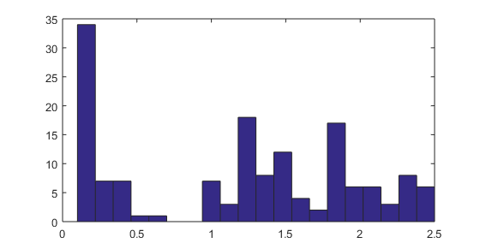
Quantitative feature
>>iris=load(‘Data/iris.dat’) % 150x4 dataset
>>w=iris(:,4); %4th feature, Petal width
>> hist(w,20); %Histogram with 20 bins
This sample is not homogeneous. In what sense?

Slide 42
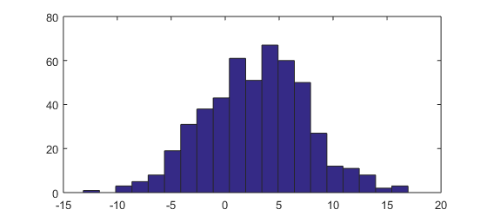
A homogeneous sample
>> x=5*randn(500,1)+3;hist(x,20);
No deep minima

Slide 43
Homogeneity and non-homogeneity
No deep minima
(homogeneity)
There are deep серьезные minima
(non-homogeneity)

Slide 44
Homogeneous groups in a non-homogeneous set
non-homogeneity
Homogeneous groups in intervals
A=[0, 0.8], B=[0.8, 1.7], C=[1.7 2.5] -
- Define a nominal (or order) feature with 3 categories, A, B C.

Slide 45
Categorized feature х, 1
Non-homogeneity
Nominal feature with 3 categories:
A=[0, 0.8], B=[0.8, 1.7], C=[1.7 2.5]
Corresponds to partition on the object set: S={S_{A}, S_{B}, S_{C}}
S_{A}={i: 0<x(i)<=0.8},
S_{B}={i: 0.8<x(i)<=1.7}, S_{C}={i: 1.7<x(i)<=2.5}

Slide 46
Categorized feature x, 2
Nominal/order feature with 3 categories:
A=[0, 0.8], B=[0.8, 1.7], C=[1.7 2.5]
Corresponds to (ordered) partition on the object set:
S={S{1}, S{2}, S{3}} What is partition?
Code:
>>f=[0 0.8 1.7 2.5];
>>for k=1:3; s{k}=find(x>f(k) & x<=f(k+1)); end;

Slide 47
Categorized feature x, 3: Distribution
Nominal/order feature with 3 categories:
A=[0, 0.8], B=[0.8, 1.7], C=[1.7 2.5]
Corresponds to partition of the object set:
S={S{1}, S{2}, S{3}}
Frequencies: [|S{1}|, |S{2}|, |S{3}|}={50, 54, 46}
Relative frequencies:
p = {50, 54, 46}/150= {0.33, 0.36, 0.31}

Slide 48
Lecture 2 Contents
Two formalizations of the concept of feature: vector and random variable
Quantitative and categorical features
Data standardization
How to categorize a quantitative feature
Partition and its distribution
K-means clustering
Interpretation of clusters
The average and its properties
Vector view
Density function view
K-means criterion.

Slide 49
K-Means clustering
Method
Issues
Interpretation of clusters
Criterion of the method

Slide 50
Clustering with K-Means, 1 K-Means iterations illustrated
Cluster k: center c_{k} and set S_{k} (k=1,…, K)
(a) Initialize (b) Assign entities to nearest
center
(c) Cluster update (d) Center update

Slide 51
Clustering with K-Means, 2 K-Means iterations formulated
Cluster k: center c_{k} and set S_{k} (k=1,…, K)
K-Means method:
0. Specify K, number of clusters, and initial centers c_{k} (k=1,…, K)
Update sets S_{k} (k=1,…, K) using Minimum distance rule
Update centers c_{k} (k=1,…, K) as means of S_{k}
If new centers coincide with the previous ones, stop. Else go to 1.

Slide 52
Clustering with K-Means, 3 Explanation of the mean
Let S be in R⁴ and consist of 3 objects
i1 = (2, 1, 2, 0)
i2 = (1, 2, 0, 1)
i3 = (3, 0, 1, 5)
----------------------
Mean: 6/3 3/3 3/3 6/3 Sum/Nk (2, 1, 1, 2)

Slide 53
Clustering with K-Means, 4 Explanation of the distance
Euclidean squared distance:
dot product of the difference by itself
d(i, c_{k})=<i-c_{k},i-c_{k} >
object i = (2, 1, 2, 0)
center c_{k} = (1, 2, 0, 1)
i- c_{k}=(2-1, 1-2, 2- 0, 0-1)=(1, -1, 2, -1)
Distance: d(i,c_{k}) =(1)²+(-1)²+(2)²+(-1)² = 7

Slide 54
Clustering with K-Means, 5 Applying K-Means method to Iris dataset
Step −1. Standardization (options):
No pre-processing
(Why? All measurements relate to elements of the same flower and use the same unit)
B. Z-scoring: Each feature centered by its mean and normalized by its standard deviation
(Why? Everybody does so)
C. Each feature centered by its mean and normalized by its range (Why? Dividing by range is better than by the standard deviation – see next slide)

Slide 55

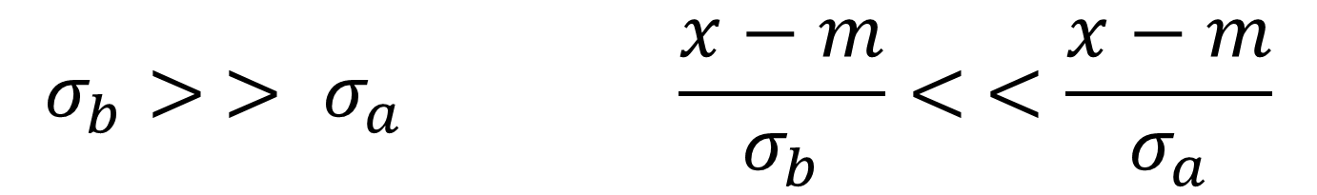
Clustering with K-Means , 6 Why dividing by range can be better than dividing by std for clustering
$$σ_{b}> > σ_{a} \frac{x−m}{σ_{b}}< <\frac{x−m}{σ_{a}}$$
Counter-intuitive: (b) divides dataset, thus better, (a) not, thus worse for clustering

Slide 56
Clustering with K-Means,7 Preprocessing options at Iris dataset
0. Specify K=3 and specimens 1, 51, 101 as initial centers (because of preliminary knowledge). Then run iterations of K-Means:
A. (No preprocessing) Converged in 4 iterations
B. (Z scoring) Converged in 7 iterations
C. (Normalizing by range) Converged in 5 iterations

Slide 57
Clustering with K-Means, 8 Confusion regarding Ground Truth
Partition of Iris dataset using K-Means method:
Ground Truth: Taxa T1 T2 T3 Total
A. (No preprocessing) 50 0 0 50 Cl1
16 errors 0 48 14 62 Cl2
0 2 36 38 Cl3
B. (Z scoring) 50 0 0 50 Cl1
28 errors 0 39 17 56 Cl2
0 11 33 44 Cl3
C. (Norm. by range) 50 0 0 50 Cl1
17 errors 0 47 14 61 Cl2
0 3 36 39 Cl3

Slide 58
Clustering with K-Means, 10 Advantages
K-Means computations model typology making (who knows: what is typology?)
Computation is intuitive
Computation is fast and requires no additional memory
Computation is easy to parallelize (big data)

Slide 59
Clustering with K-Means, 11 Issues of K-Means
Would the K-Means computations ever stop?
Results depend of the initialization (see next slide): How should one initialize?
Choosing the number of clusters K?
To address, let us do a bit of theory

Slide 60
Clustering with K-Means, 12 Results heavily depend of the initialization
Two clearly visible
clusters case.
Top:
Reasonable location
of initial centroids
Bottom:
Asymmetric initial centers lead to wrong clustering results

Slide 61
Lecture 2 Contents
Two formalizations of the concept of feature: vector and random variable
Quantitative and categorical features
Data standardization
How to categorize a quantitative feature.
Partition and its distribution.
K-means clustering.
K-means criterion and convergence.
Interpretation of clusters.
The average and its properties
DA: Vector view
CS: Density function view

Slide 62
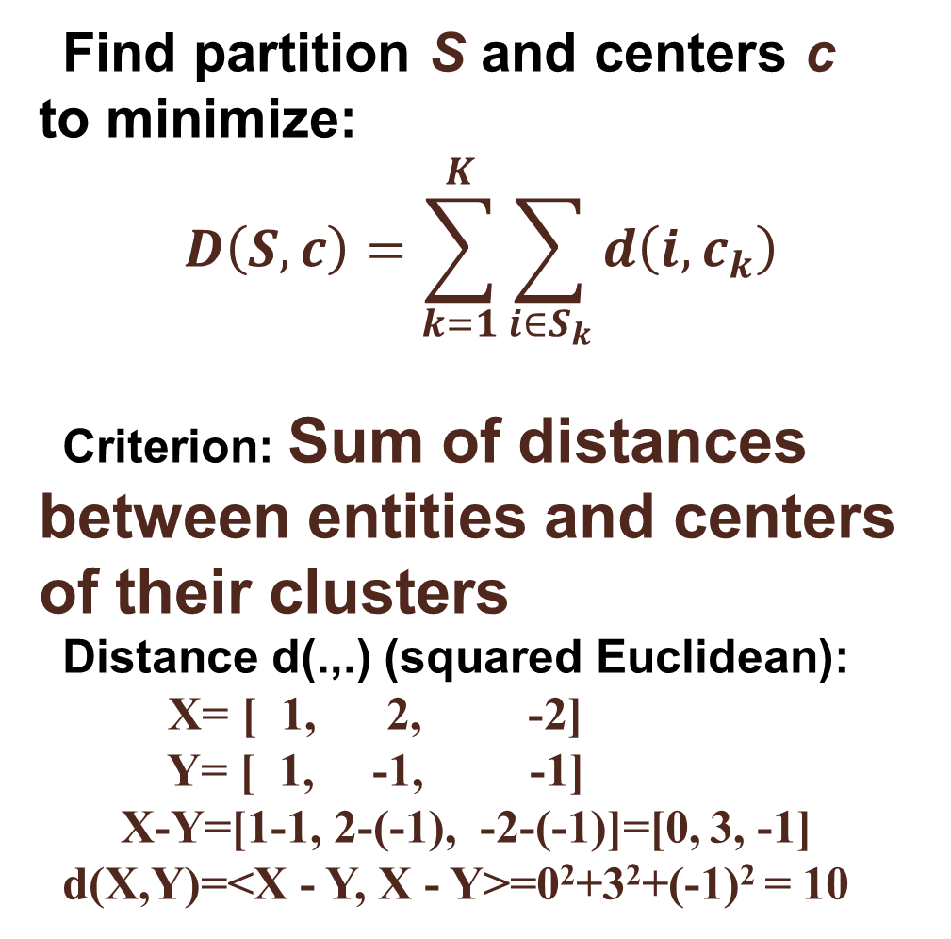
Clustering with K-Means, 13 K-Means criterion:
Find partition S and centers c to minimize:
$$D\left(S,c\right)=\sum_{k=1}^{K}{\sum_{i∈S_{k}}{d\left(i,c_{k}\right)}}$$
Criterion: Sum of distances between entities and centers of their clusters
Distance d(.,.) (squared Euclidean):
X= [ 1, 2, -2]
Y= [ 1, -1, -1]
X-Y=[1-1, 2-(-1), -2-(-1)]=[0, 3, -1]
d(X,Y)=<X - Y, X - Y>=0²+3²+(-1)² = 10

Slide 63
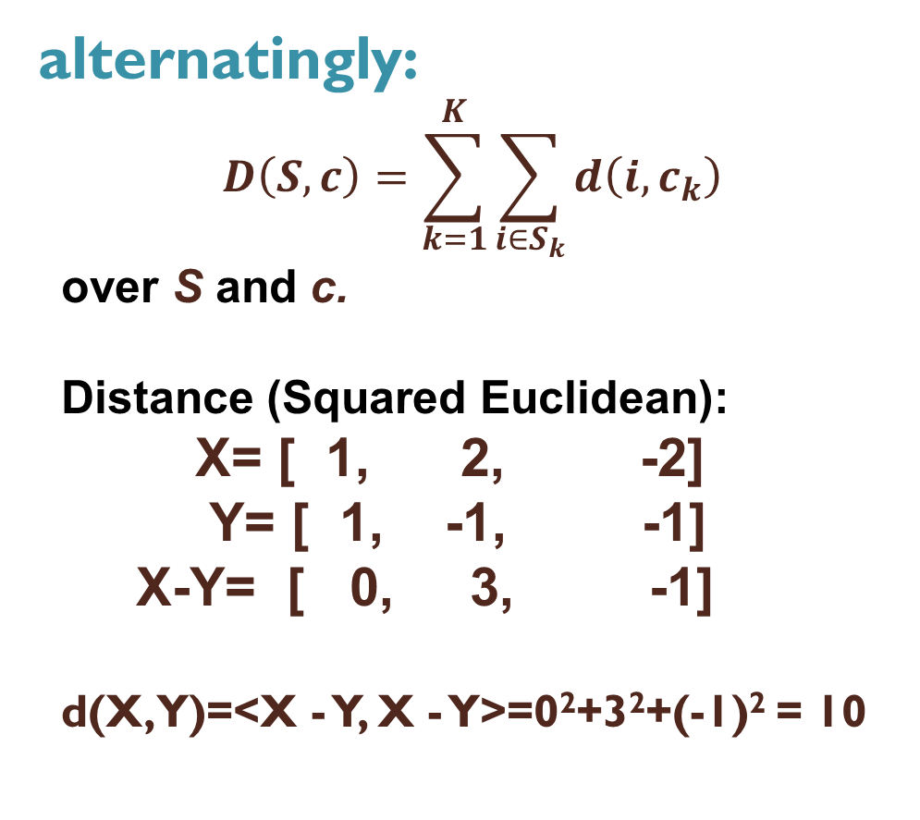
K-Means criterion, 1 K-Means = alternating minimization of D(S,c)
Minimize D(S,c)
Min_{S} D(S, c):
- Clusters update
Min_{c} D(S, c):
- Centers update
D(S,c) decreases at each step:
Convergence – why? (QUIZ)
alternatingly:
$$D\left(S,c\right)=\sum_{k=1}^{K}{\sum_{i∈S_{k}}{d\left(i,c_{k}\right)}}$$
over S and c.
Distance (Squared Euclidean):
X= [ 1, 2, -2]
Y= [ 1, -1, -1]
X-Y= [ 0, 3, -1]
d(X,Y)=<X - Y, X - Y>=0²+3²+(-1)² = 10

Slide 64
Pythagorean decomposition,1
K-Means criterion:
T = F(S,c) + D(S,c)
Data_Scatter = “Explained Part”+”Unexplained Part”

Slide 65
Pythagorean decomposition,2
K-Means criterion:
For proof and more, see Sections 4.3.1 and 4.3.2, pp. 323-326 in Textbook by Mirkin (2019(

Slide 66
Lecture 2 Contents
Two formalizations of the concept of feature: vector and random variable
Quantitative and categorical features
Data standardization
How to categorize a quantitative feature.
Partition and its distribution.
K-means clustering.
K-means criterion.
Interpretation of clusters through means
The average and its properties
Vector view
Density function view

Slide 67
Clustering with K-Means, 9 Cluster interpretation
Center c_{k} for Interpretation of cluster S_{k}:
Iris taxon T1: Specimens number 1, 2, …, 50
Taxon T1 Interpretation: SMALL PETAL
 | SLength | SWidth | PLength | PWidth
Within-cluster mean | 5.006 | 3.428 | 1.462 | 0.246
Grand mean | 5.843 | 3.057 | 3.758 | 1.199
Difference | −0.837 | 0.371 | −2.296 | −0.953
Difference, % | −14.3 | +12.1 | −61.1 | −79.5

Slide 68
Take a look at the Supplement to Lecture 2: Detailed advice on cluster interpretation

Slide 69
Lecture 2 Contents
Two formalizations of the concept of feature: vector and random variable
Quantitative and categorical features
Data standardization
How to categorize a quantitative feature.
Partition and its distribution.
K-means clustering.
K-means criterion.
Interpretation of clusters through means
The average/mean and its properties
Vector view
Density function view

Slide 70
What is a vector feature center,1
Consider a feature over N entities (transposed)
x = (x₁, x₂, …, x_{N})
Data Analysis view
Def. Center of x is a value c satisfying equations
x_{i} = c + e_{i}, for all i=1,2,…, N
at as small residuals e_{i} as possible
Def. L_{p}=[|e₁|^{p}+|e₂|^{p}+…+ |e_{N}|^{p} ]/N
Minkowski criterion: min L_{p}

Slide 71
What is a feature vector center, 2
Data analysis view: Minkowski p-center (p ≥ 1)
Minimize L_{p}=[|c-x₁|^{p}+|c-x₂|^{p}+…+ |c-x_{N}|^{p} ]/N
with respect to all possible c
At different p, different solutions!
L_{p} is a measure of spread of the feature around center

Slide 72
Minkowski distance: curve x^{p}+y^{p}=1 at different p
P=5
P=3
P=2
P=1.5
P=1

Slide 73
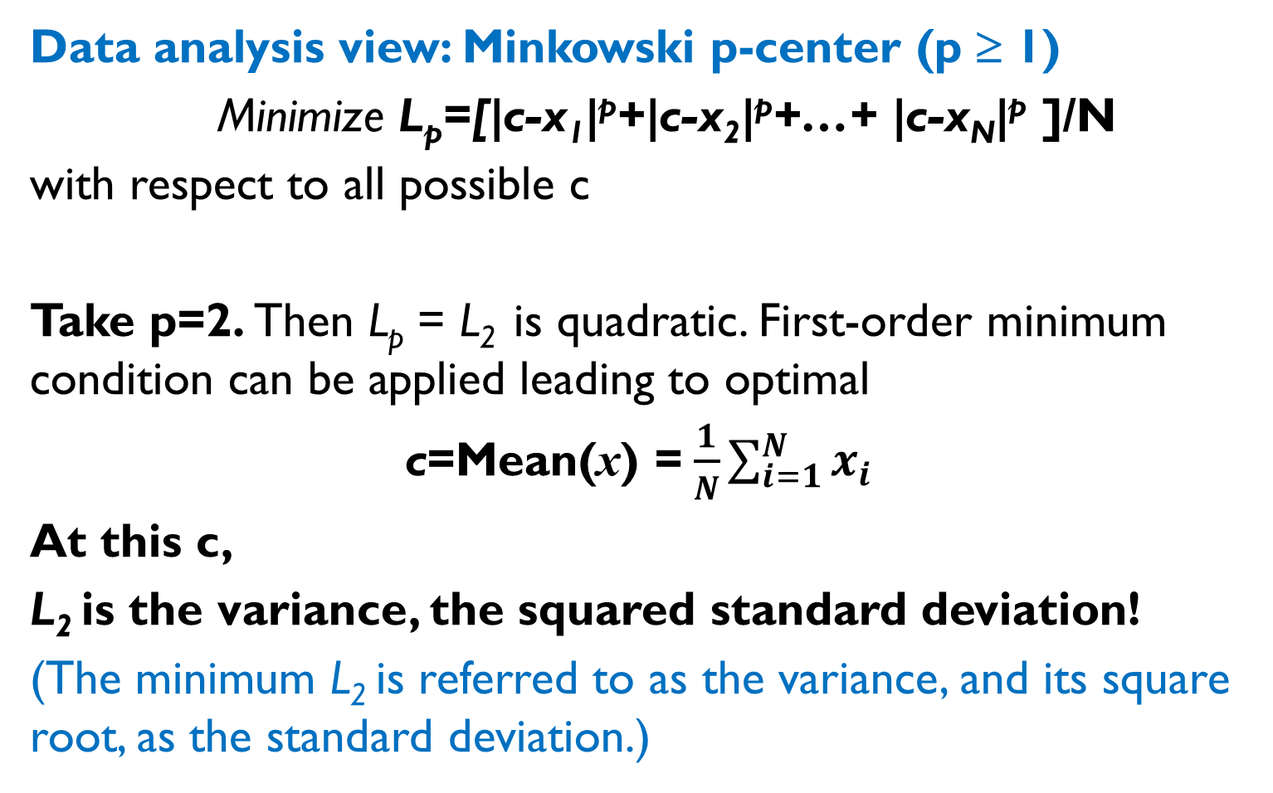
What is center, 3
Data analysis view: Minkowski p-center (p ≥ 1)
Minimize L_{p}=[|c-x₁|^{p}+|c-x₂|^{p}+…+ |c-x_{N}|^{p} ]/N
with respect to all possible c
Take p=2. Then L_{p} = L₂ is quadratic. First-order minimum condition can be applied leading to optimal
c=Mean(x) =$\frac{1}{N}\sum_{i=1}^{N}{x_{i}}$
At this c,
L₂ is the variance, the squared standard deviation!
(The minimum L₂ is referred to as the variance, and its square root, as the standard deviation.)

Slide 74
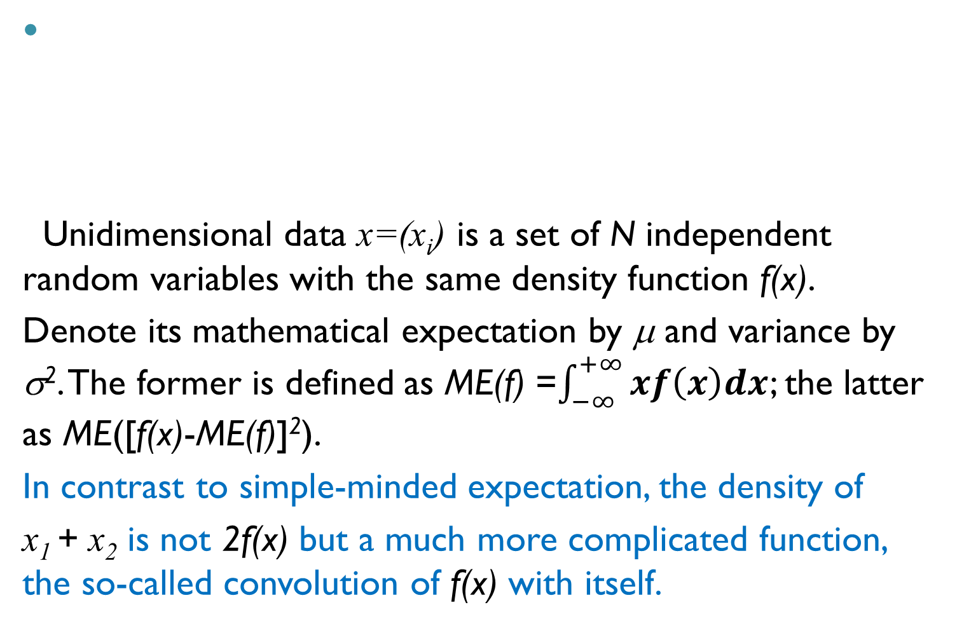
What is center, 4: Classical statistics view
Unidimensional data x=(x_{i}) is a set of N independent random variables with the same density function f(x).
Denote its mathematical expectation by μ and variance by σ². The former is defined as ME(f) =$\int_{−∞}^{+∞}{xf\left(x\right)dx}$; the latter as ME([f(x)-ME(f)]²).
In contrast to simple-minded expectation, the density of
x₁ + x₂ is not 2f(x) but a much more complicated function, the so-called convolution of f(x) with itself.
f(x)
0 x

Slide 75
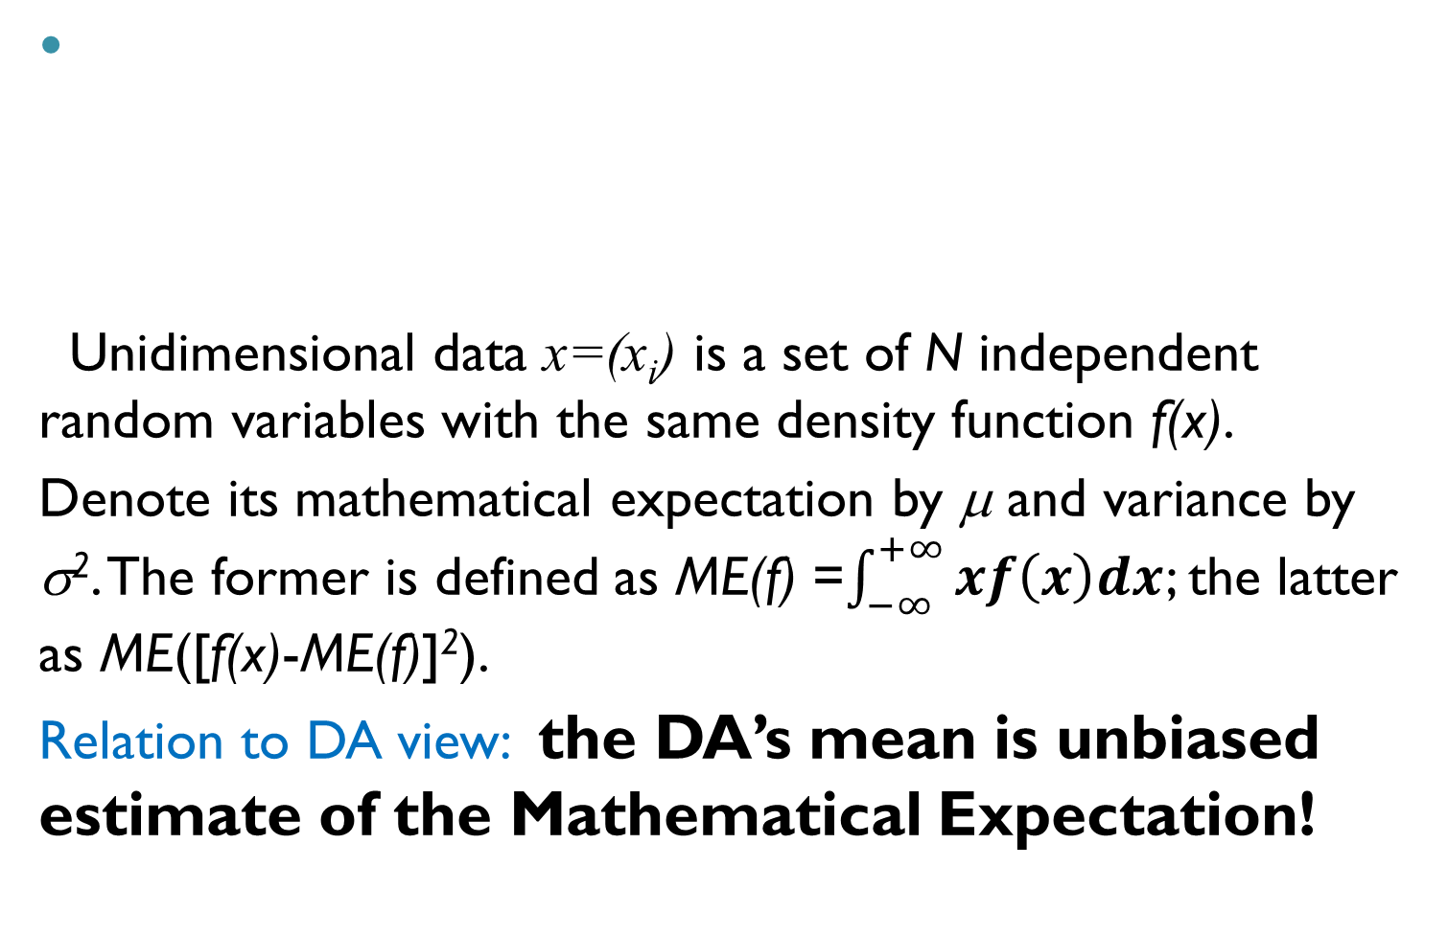
What is center, 5: Classical statistics view
Unidimensional data x=(x_{i}) is a set of N independent random variables with the same density function f(x).
Denote its mathematical expectation by μ and variance by σ². The former is defined as ME(f) =$\int_{−∞}^{+∞}{xf\left(x\right)dx}$; the latter as ME([f(x)-ME(f)]²).
Relation to DA view: the DA’s mean is unbiased estimate of the Mathematical Expectation!
f(x)
0 x

Slide 76
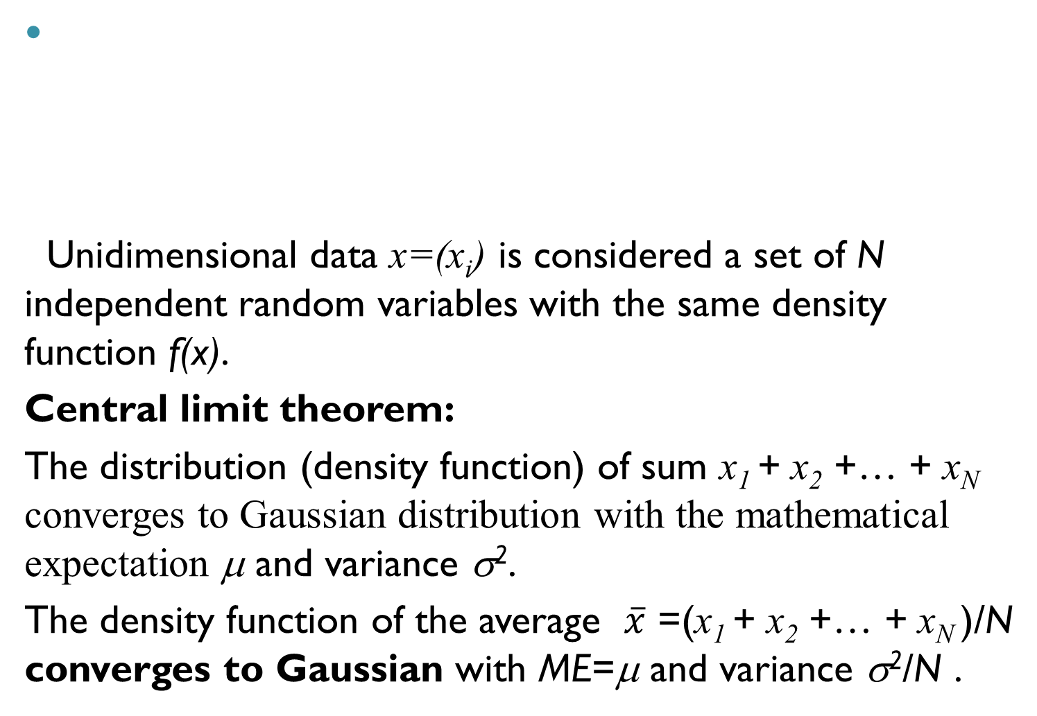
What is center, 6: Classical statistics view
Unidimensional data x=(x_{i}) is considered a set of N independent random variables with the same density function f(x).
Central limit theorem:
The distribution (density function) of sum x₁ + x₂ +… + x_{N} converges to Gaussian distribution with the mathematical expectation μ and variance σ².
The density function of the average $\overline{x}$ =(x₁ + x₂ +… + x_{N} )/N converges to Gaussian with ME=μ and variance σ²/N .
f(x)
0 x

Slide 77
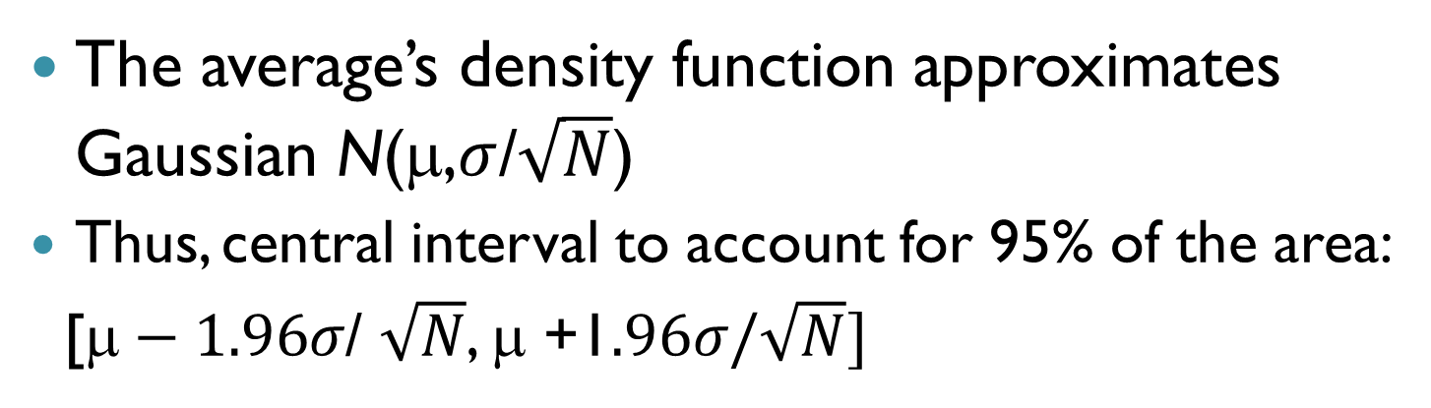
Center, 7: Classical statistics view
The average’s density function approximates Gaussian N(μ,$σ$/$\sqrt{N}$)
Thus, central interval to account for 95% of the area:
[$\text{}−1.96σ$/ $\sqrt{N}$, μ +1$.96σ/\sqrt{N}]$

Slide 78
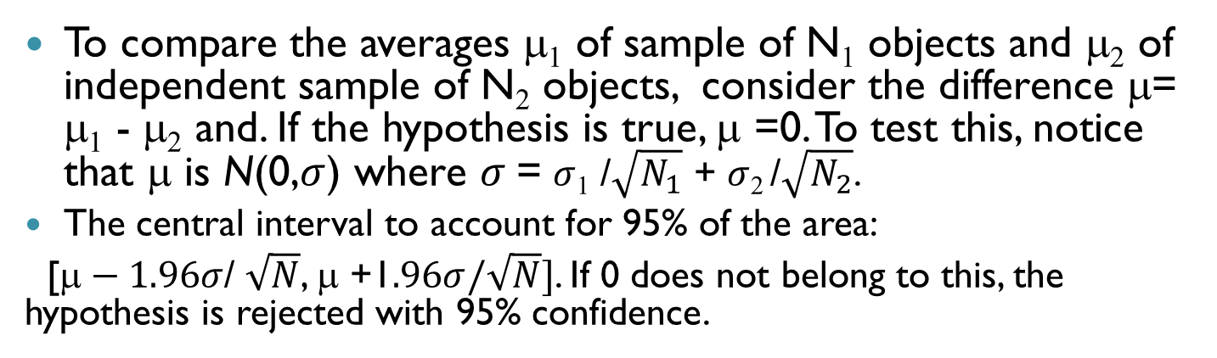
Center, 8: Classical statistics view
To compare the averages μ₁ of sample of N₁ objects and μ₂ of independent sample of N₂ objects, consider the difference μ= μ₁ - μ₂ and. If the hypothesis is true, μ =0. To test this, notice that μ is N(0,$σ$) where $σ$= $σ$₁ /$\sqrt{N_{1}}$ + $σ$₂ /$\sqrt{N_{2}}$.
The central interval to account for 95% of the area:
[$\text{}−1.96σ$/ $\sqrt{N}$, μ +1$.96σ/\sqrt{N}]$. If 0 does not belong to this, the hypothesis is rejected with 95% confidence.

Slide 79
Center, 9: Classical statistics view
The distribution density function and its central interval to account for 95% of the area can be estimated computationally via what is called bootstrap (will be studied later)
If 0 does not belong to this, the hypothesis is rejected with 95% confidence.

Slide 80
Keeping up: How to prepare yourself to the next lecture:
After the lecture, put down main concepts that have been discussed in the lecture and think a few minutes of what do they mean
Just before the next lecture: Take a few minutes and look through the slides of the previous lecture

Slide 81
Home work 1, to finish by 21/09:
1. Each to form/join a team of up to 4; the team finds a meaningful dataset of their liking on the internet as advised in Lecture 1
Number of entities ≥ 90, of features ≥ 7
No missings
No Irivine ML repository
The dataset is to be presented to me according to rules of the next slide by 21 September.
2. Start writing a team’s report file
Project title page, then
Section 1.
Explanation of the choice of the dataset
Information of the dataset: features, number of entities, source address, examples of problems

Slide 82
Modern Data Analysis Home Work 2020: Start and Deadline, 1
Goals:
Hands-on experience in data analysis methods learnt
Report writing experience
A report submitting team may consist of up to 4 persons: all are to receive the same mark.
To start, you should receive a confirmation from myself. To obtain that, you should submit to me a description of the dataset (what are the entities, the number of them, a list of features with explanation of their meaning, and a file with the dataset).

